Slide 1
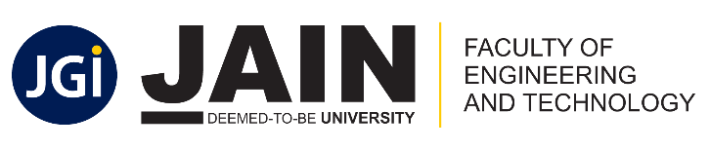
Department of Computer Science & Engineering
Batch Number: 36
Synopsis Presentation on
Food Demand Forecasting Using Machine Learning
Vikash Kumar(19BTRCS105)
Vishal Vijay Krit Kumar(19BTRCS118)
Dr. Rajat
Associate Professor
Jain University, Bangalore

Slide 2
Abstract
There are a lot challenges in demand and supply of the food chain.
The accurate analysis is required to maintain the process smooth.
Using the machine learning algorithm, we can predict the future demand to be maintained in the stock.
There will be no excess hoarding of the product, which helps in optimizing the operational cost of the company.
It will make the company to lead in the market among various competitors.
Eventually, it will definitely prevents the wastage of food.

Slide 3
Introduction
Retail food delivery is a courier service in which a restaurant, store, or independent food-delivery company delivers food to a customer.
An order is typically made either through a restaurant or grocer's website or mobile app, or through a food ordering company.
The delivered items can include entrees, sides, drinks, desserts, or grocery items and are typically delivered in boxes or bags.
A food delivery service has to deal with a lot of perishable raw materials which makes it all, the most important factor for such a company is to accurately forecast daily and weekly demand.
Too much inventory in the warehouse means more risk of wastage, and not enough could lead to out-of-stocks - and push customers to seek solutions from your competitors.
The replenishment of majority of raw materials is done on weekly basis and since the raw material is perishable, the procurement planning is of utmost importance, the task is to predict the demand for the next 10 weeks.

Slide 4
Objectives and Scope of the Project
The main aim of this project is to create an appropriate machine learning model to forecast the demand of product in the market in coming days.
It will help the organisation to prevent hoarding of product from overstocked.
It will aid to prevention of food wastage in the society.
It will help the orgainsation to optimize the budget to maintain the inventory.

Slide 5
Methodology
The main aim is to analyse and predict the future requirements of the product.
To achieve it, we should have the dataset of the past orders to make the trends and analysis based on past requirements of products.
We will use machine learning model which contains different features,i.e., city code, area, sales, food items, etc.
Our model will use the frontend which will be integrated with machine learning model at the backend, which will take input from the user and then predicts the future demand of the respective product.

Slide 6
Hardware & Software Requirements
The web application uses Python (3.6 or above recommended) on the backend(using Flask) and uses HTML & CSS on frontend to power it.
Python packages will be used:
1. pandas
2. numpy
3. scikit learn
4. matplotlib
5. seaborn
6. xgboost
7. Flask

Slide 7
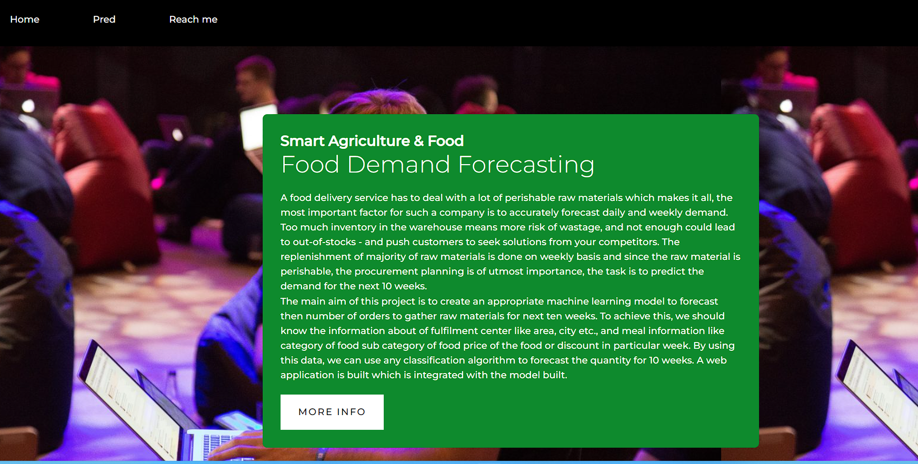
Results & Outcomes
Screenshot 1:

Slide 8
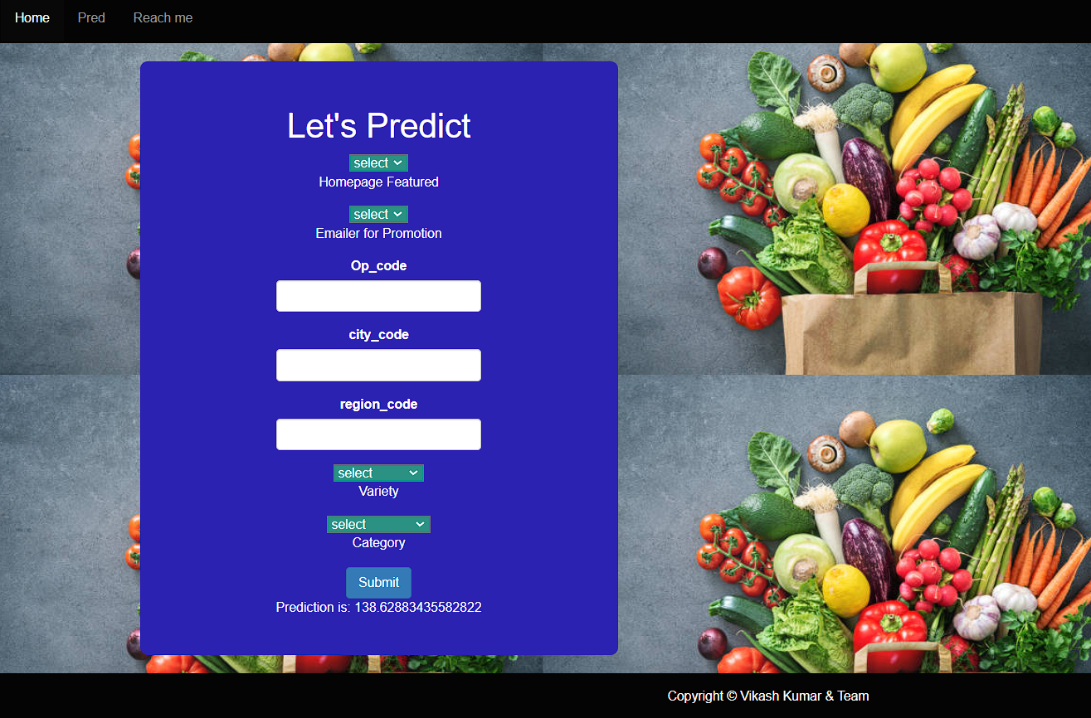
Results & Outcomes
Screenshot 2:

Slide 9
References/Bibiliography
Kaggle
Youtube
Udemy

Slide 10
Thank You!!! :-)
Any Questions?

